Slide 1

AI Sign Language Detector: Bridging Communication Gaps
This project creates a real-time sign language translator using CNN models.
It enables seamless communication for the deaf community, improving accessibility.

Slide 2
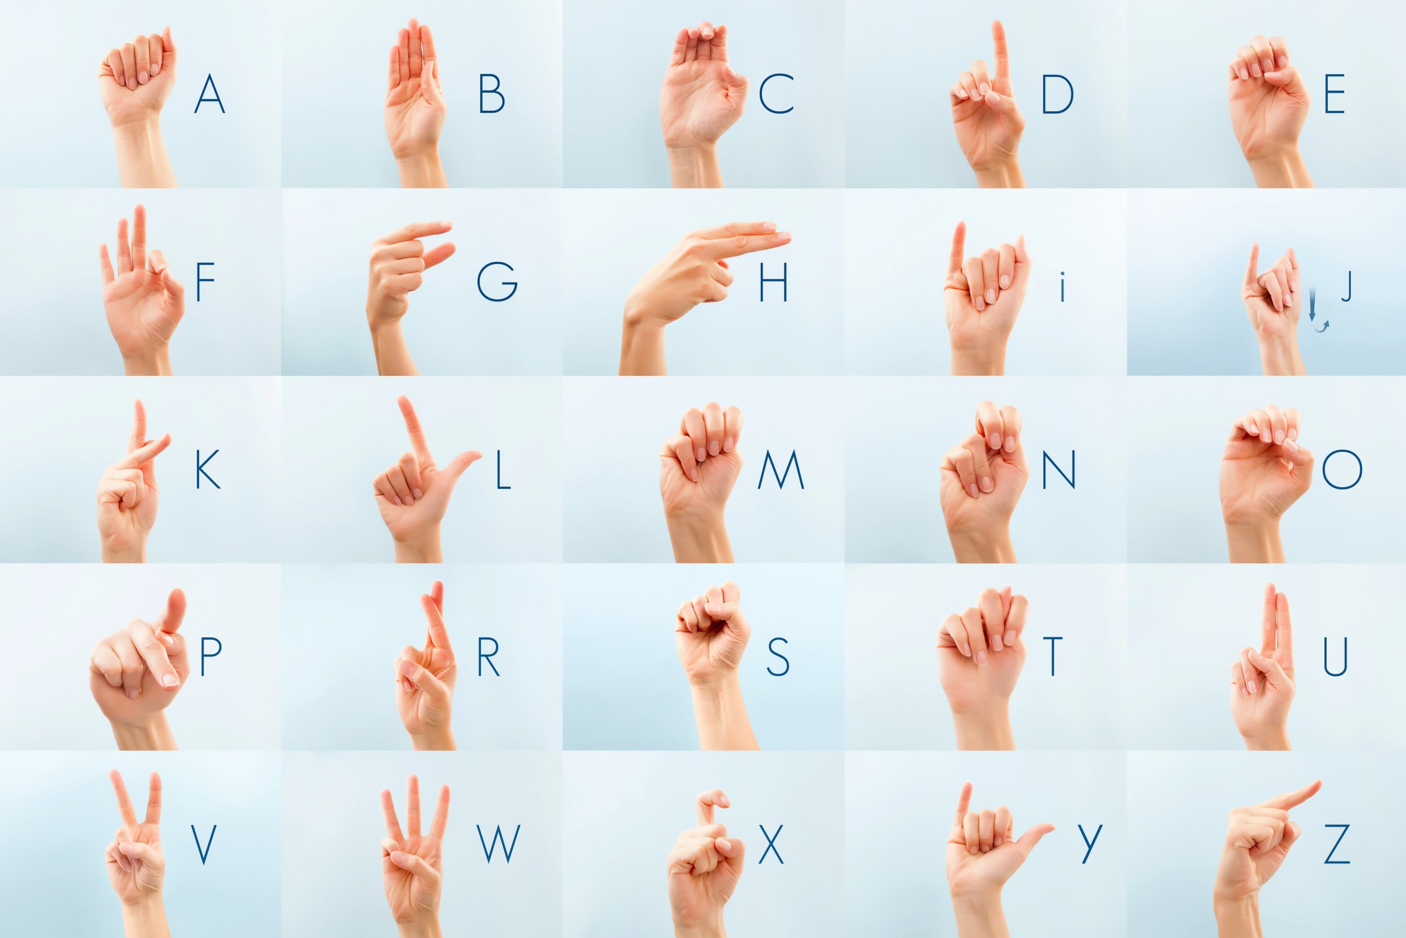

Slide 3
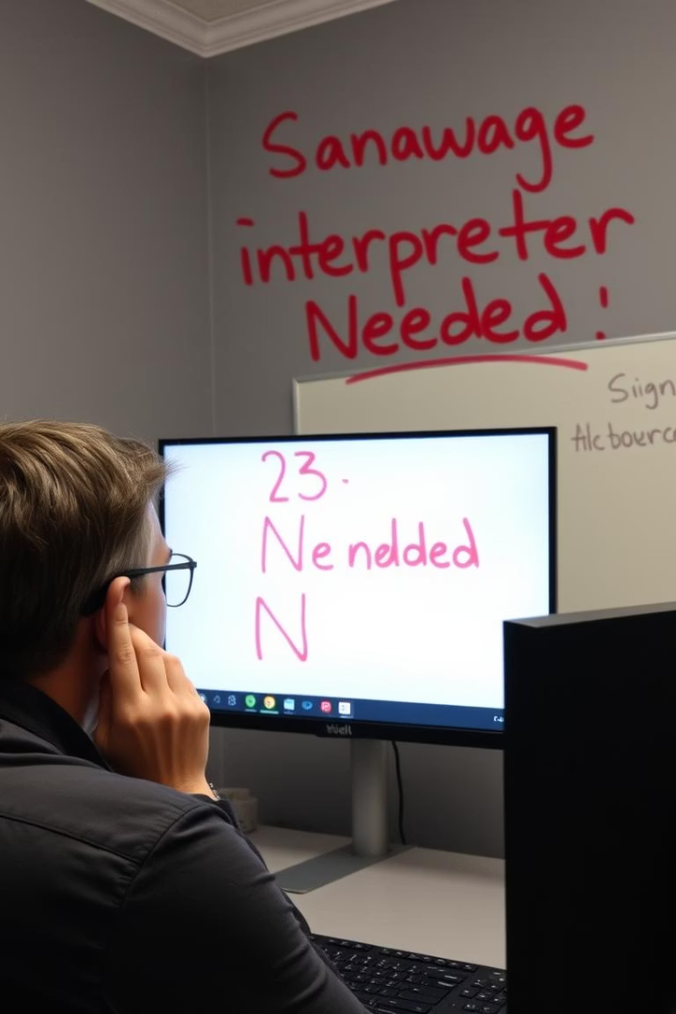
Understanding the Challenge
Sign Language Complexity
Interpreter Scarcity
Only 1 interpreter per 78 deaf individuals, creating communication barriers.
Visual-spatial and varies by region, making universal translation tough.
Market Demand
Current market exceeds $650M, highlighting need for affordable solutions.

Slide 4





CNN Model Architecture
Input Layer
Processes video feeds capturing sign gestures.
Convolutional Layers
Extract features like edges, shapes, and motion.
Max Pooling
Reduces data dimensions for efficiency.
Recurrent Layers (LSTM)
Analyzes temporal context of gestures over time.
Output Layer
Generates predicted text translation.

Slide 5
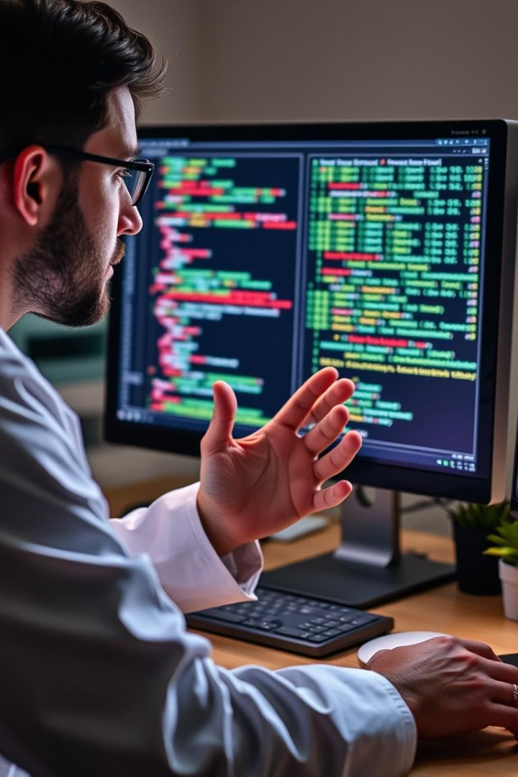
Dataset and Training
Dataset
ASL Alphabet + custom signs
Augmentation
Rotation, scaling, noise to improve robustness
Metrics
Accuracy, precision, recall, F1-score
Results
95% accuracy on ASL, 92% on custom signs

Slide 6





Real-time Implementation
OpenCV
TensorFlow Lite
Flask API
Low Latency
For efficient video processing
Optimizes model for mobile devices
Handles device communication
<200ms delay on mobile devices

Slide 7
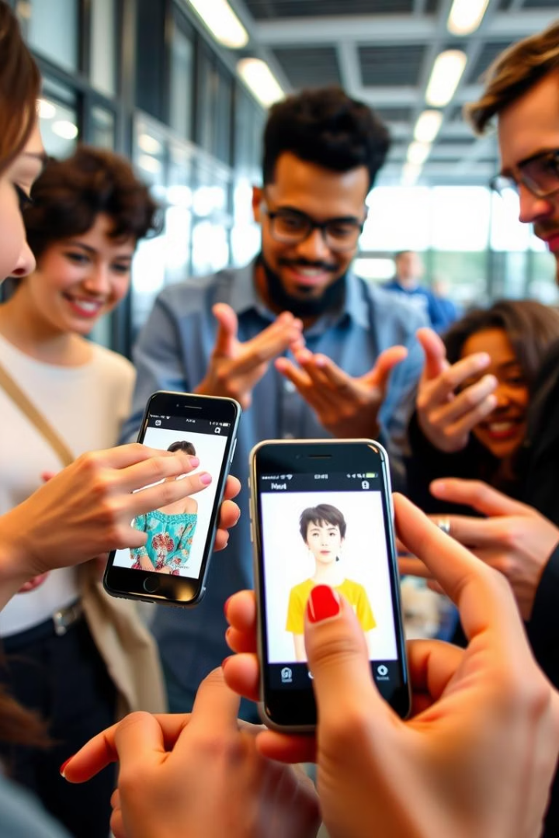
User Interface and Experience
Cross-Platform WebPage
Available on all platforms
Customizable Dialects
Supports regional sign variations
Offline Mode
Access pre-downloaded signs without internet
User Feedback
Continuous improvements through user input
The app targets 70 million deaf users worldwide.

Slide 8





Future Enhancements
Multi-Signer Support
Expand Vocabulary
2
Enable group conversations
Include complex grammar and phrases
1
Emotion Recognition
Detect sentiment in signs
3
5
Smart Device Integration
AR/VR Integration
Enhance accessibility at home
4
Create immersive communication experiences

Slide 9

Impact and Conclusion
Empowerment
Give voice to deaf individuals
Barrier Removal
Break down communication obstacles
Accessibility
Democratize access to info and services
Inclusion
Promote a more inclusive society

